Slide 1
Spatial filtering for image sharpening
Background: To highlight fine detail in an image or to enhance blurred detail
Applications: Electronic printing, medical imaging, industrial inspection, autonomous target detection (smart weapons)......
Foundation:
Blurring/smoothing is performed by spatial averaging (equivalent to integration)
Sharpening is performed by noting only the gray level changes in the image that is the differentiation
COMSATS University Islamabad, Lahore Campus Digital Image Processing CSD 331

Slide 2
Spatial filtering for image sharpening
Operation of Image Differentiation
Enhance edges and discontinuities
De-emphasize areas with slowly varying gray-level values
Mathematical Basis of Filtering for Image Sharpening
Implementation by mask filtering
First-order and second-order derivatives
COMSATS University Islamabad, Lahore Campus Digital Image Processing CSD 331

Slide 3
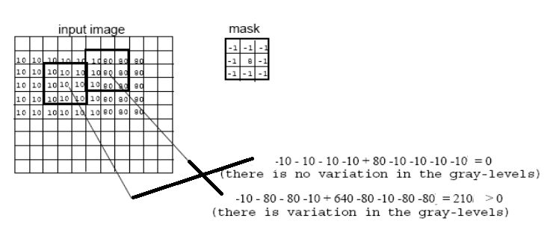
Sharpening Filters (High Pass filtering)
Useful for emphasizing transitions in image intensity (e.g., edges).
COMSATS University Islamabad, Lahore Campus Digital Image Processing CSD 331

Slide 4
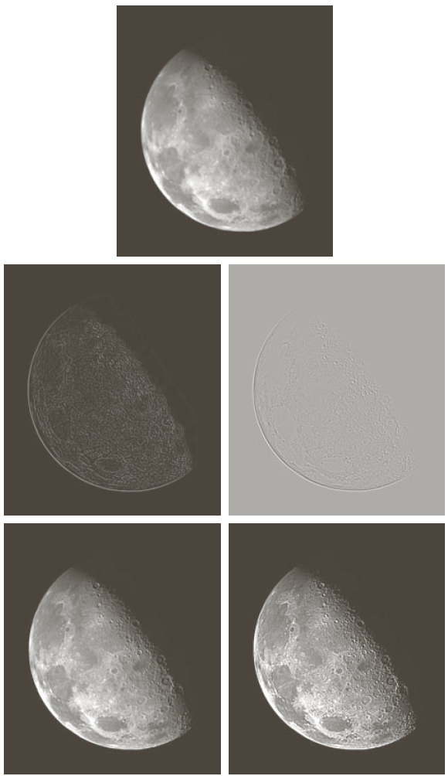
Sharpening Filters (High Pass filtering)
Note that the response of high-pass filtering might be negative.
Values must be re-mapped to [0, 255]
original image
sharpened images
COMSATS University Islamabad, Lahore Campus Digital Image Processing CSD 331

Slide 5
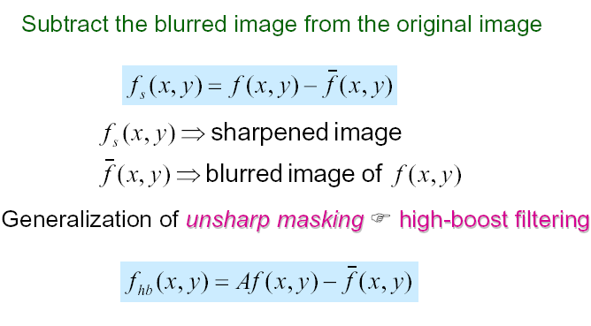



Sharpening Filters: Unsharp Masking
Obtain a sharp image by subtracting a lowpass filtered (i.e., smoothed) image from the original image:
-
=
COMSATS University Islamabad, Lahore Campus Digital Image Processing CSD 331

Slide 6
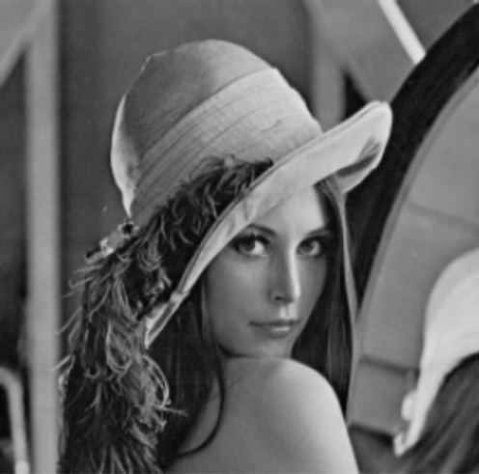

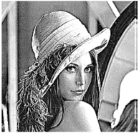

Sharpening Filters: Unsharp Masking (cont’d)
If A=1, we get a high pass filter
If A>1, part of the original image is added back to the high pass filtered image.
A=1.4
A=1.9
COMSATS University Islamabad, Lahore Campus Digital Image Processing CSD 331

Slide 7
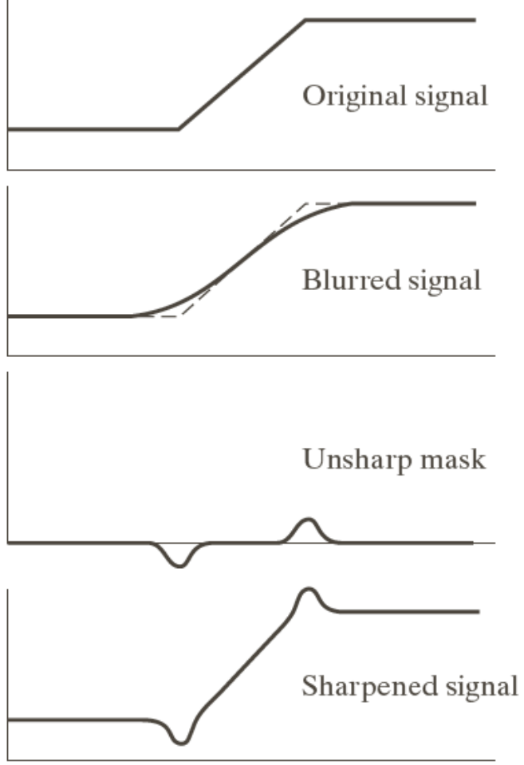
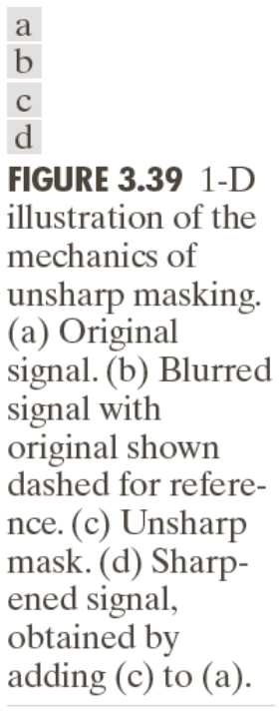

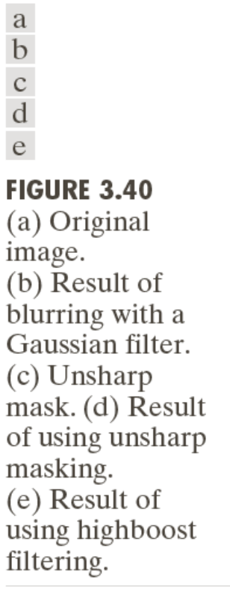
Unsharp Masking (cont’d)
COMSATS University Islamabad, Lahore Campus Digital Image Processing CSD 331

Slide 8
Image sharpening (High-Pass Filters)
Spatial filters whose effect on the output image is equivalent to preserving or emphasizing its high-frequency components (e.g., fine details, points, lines, and edges), i.e. to highlight transitions in intensity within the image.
Linear HPFs can be implemented using 2D masks with positive and negative weights / coefficients, (Laplacian, a simple, isotropic (i.e., rotation invariant) second-order derivative)
COMSATS University Islamabad, Lahore Campus Digital Image Processing CSD 331

Slide 9
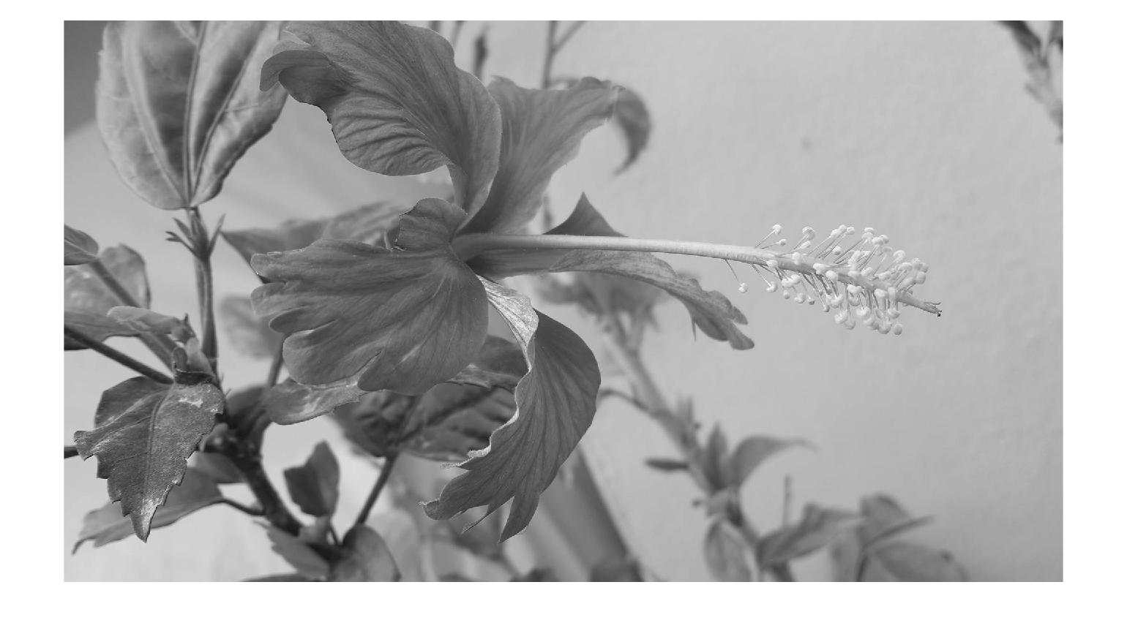
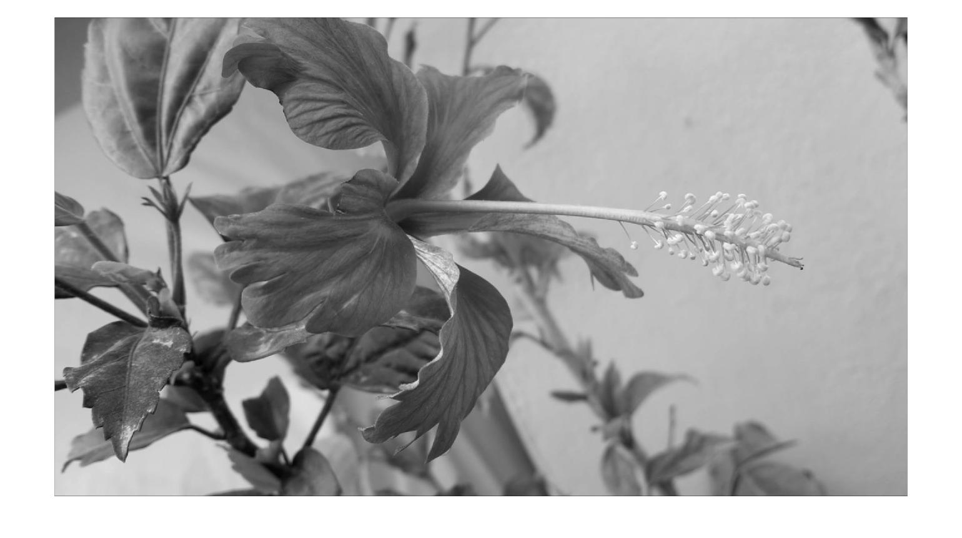
Filter Examples
Example 1:
  myFilter1 = [1 1 1; 1 1 1; 1 1 1];
  myOrigImage = rgb2gray(imread(‘Flower.jpg'));
  figure; imshow(myOrigImage);
  myFilteredImage = imfilter(double(myOrigImage),myFilter1);
  figure; imshow(myFilteredImage,[]);
COMSATS University Islamabad, Lahore Campus Digital Image Processing CSD 331

Slide 10
Filter Examples
Example 2:
  myFilter2 = [0 0 0; 0 1 0; 0 0 0];
  myOrigImage = rgb2gray(imread(‘Flower.jpg'));
  figure; imshow(myOrigImage);
  myFilteredImage2 = imfilter(double(myOrigImage),myFilter2);
  figure; imshow(myFilteredImage2,[]);
COMSATS University Islamabad, Lahore Campus Digital Image Processing CSD 331

Slide 11

Filter Examples (Slight Blur)
Example 3:
  myFilter3 = 1/13*[0 0 1 0 0; 0 1 1 1 0; 1 1 1 1 1; 0 1 1 1 0; 0 0 1 0 0];
  myOrigImage = rgb2gray(imread(‘Flower.jpg'));
  figure; imshow(myOrigImage);
  myFilteredImage3 = imfilter(double(myOrigImage),myFilter3);
  figure; imshow(myFilteredImage3,[]);
COMSATS University Islamabad, Lahore Campus Digital Image Processing CSD 331

Slide 12

Filter Examples (Motion Blur)
Example 4:
  myFilter4 = 1/9*eye(9)
  myOrigImage = rgb2gray(imread(‘Flower.jpg'));
  figure; imshow(myOrigImage);
  myFilteredImage4 = imfilter(double(myOrigImage),myFilter4);
  figure; imshow(myFilteredImage4,[]);
COMSATS University Islamabad, Lahore Campus Digital Image Processing CSD 331

Slide 13
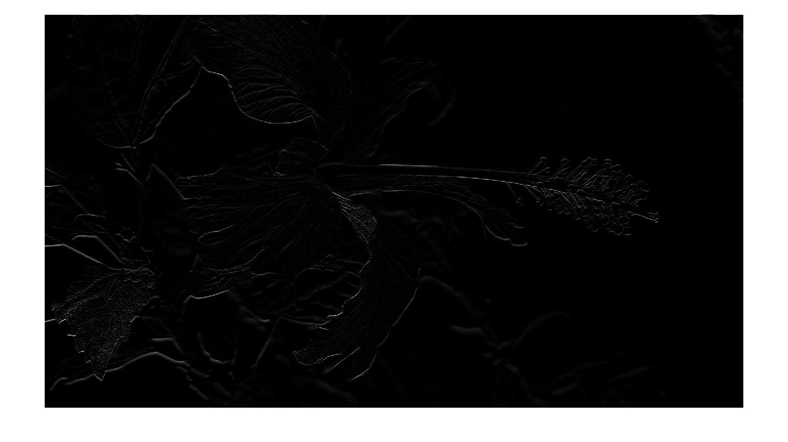
Filter Examples (Edges)
Example 5:
  myFilter5 = zeros (5,5);
  myFilter5(1:2,3) = -1;
  myFilter5(3,3) = 2
  myOrigImage = rgb2gray(imread(‘Flower.jpg'));
  figure; imshow(myOrigImage);
  myFilteredImage5 = imfilter(double(myOrigImage),myFilter5);
  figure; imshow(myFilteredImage5,[]);
COMSATS University Islamabad, Lahore Campus Digital Image Processing CSD 331

Slide 14
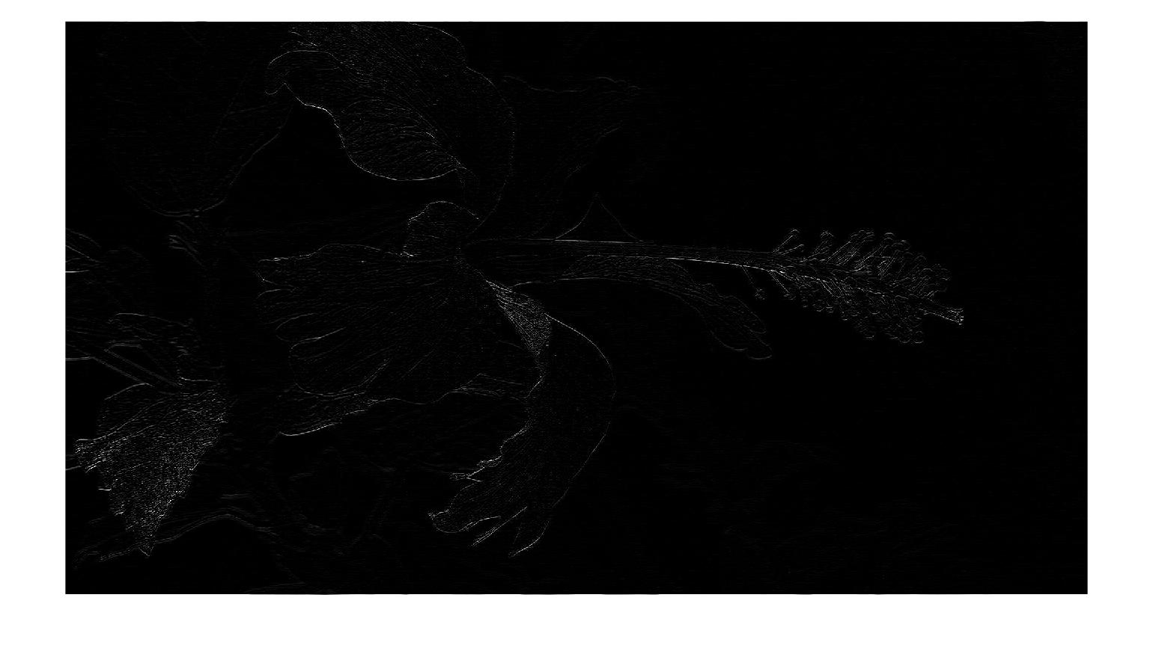
Filter Examples (Edges)
Example 6:
  myFilter6 = zeros (5,5);
  myFilter6(1:2,3) = -1;
  myFilter6(4:5,3) = -1;
  myFilter6(3,3) = 4;
  myOrigImage = rgb2gray(imread(‘Flower.jpg'));
  figure; imshow(myOrigImage);
  myFilteredImage6 = imfilter(myOrigImage,myFilter6);
  figure; imshow(myFilteredImage6,[]);
COMSATS University Islamabad, Lahore Campus Digital Image Processing CSD 331

Slide 15
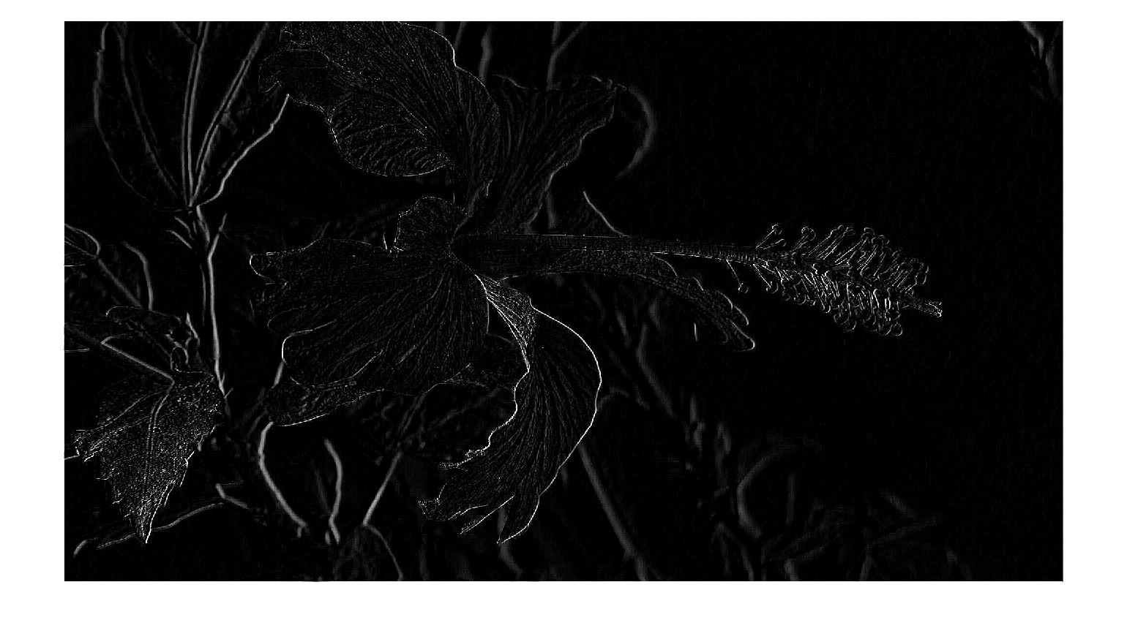
Filter Examples (Edges)
Example 7:
  myFilter7 = [-1 -1 -1; -1 8 -1; -1 -1 -1];
  myOrigImage = rgb2gray(imread(‘Flower.jpg'));
  figure; imshow(myOrigImage);
  myFilteredImage7 = imfilter(myOrigImage,myFilter7);
  figure; imshow(myFilteredImage7,[]);
COMSATS University Islamabad, Lahore Campus Digital Image Processing CSD 331

Slide 16

Filter Examples (Edges)
Example 8:
  myFilter8 = [-1 -1 -1; -1 9 -1; -1 -1 -1];
  myOrigImage = rgb2gray(imread(‘Flower.jpg'));
  figure; imshow(myOrigImage);
  myFilteredImage8 = imfilter(myOrigImage,myFilter8);
  figure; imshow(myFilteredImage8,[]);
COMSATS University Islamabad, Lahore Campus Digital Image Processing CSD 331

Slide 17

Filter Examples (Emboss)
Example 9:
  myFilter9 = [-1 -1 0; -1 0 1; 0 1 1];
  myOrigImage = rgb2gray(imread(‘Flower.jpg'));
  figure; imshow(myOrigImage);
  myFilteredImage9 = imfilter(myOrigImage,myFilter9);
  figure; imshow(myFilteredImage9,[]);
COMSATS University Islamabad, Lahore Campus Digital Image Processing CSD 331

Slide 18
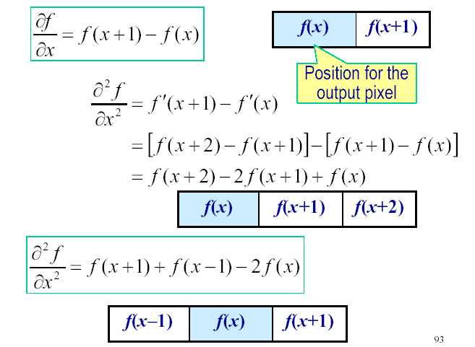
First-order and second-order derivatives
COMSATS University Islamabad, Lahore Campus Digital Image Processing CSD 331

Slide 19

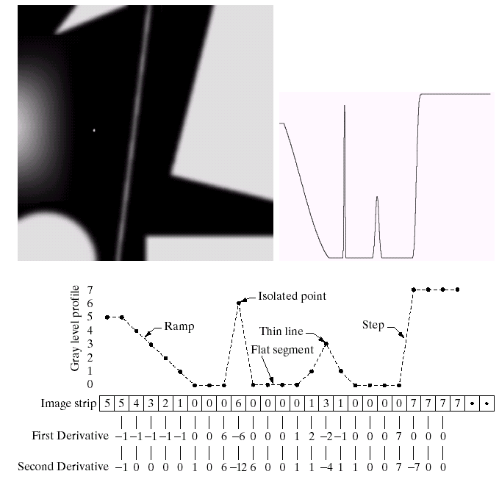
Example for discrete derivatives
COMSATS University Islamabad, Lahore Campus Digital Image Processing CSD 331

Slide 20
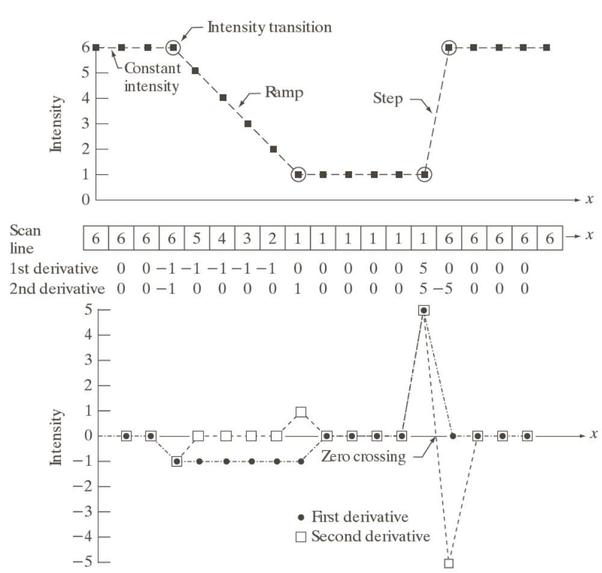
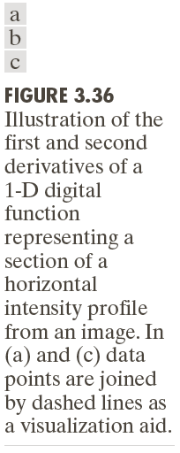
Example for discrete derivatives
COMSATS University Islamabad, Lahore Campus Digital Image Processing CSD 331

Slide 21
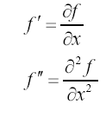
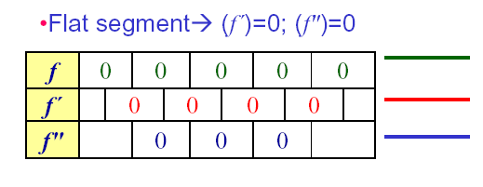
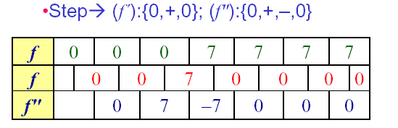
Various situations encountered for derivatives
COMSATS University Islamabad, Lahore Campus Digital Image Processing CSD 331

Slide 22
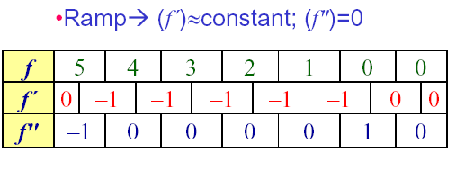
Various situations encountered for derivatives
Ramps or steps in the 1D profile normally characterize the edges in an image
f ″ is nonzero at the onset and end of the ramp:
produces thin (double) edges
f ′ is nonzero along the entire ramp: produces thick edges
COMSATS University Islamabad, Lahore Campus Digital Image Processing CSD 331

Slide 23
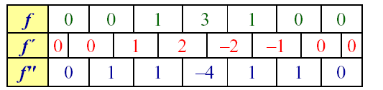
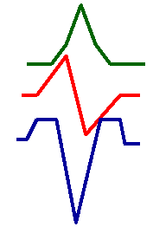
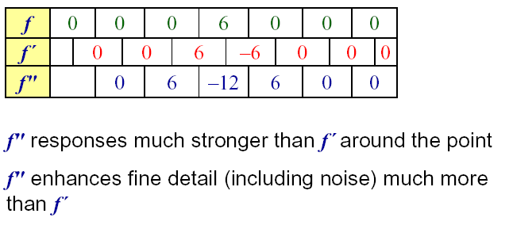
Various situations encountered for derivatives
Thin lines
Isolated point
COMSATS University Islamabad, Lahore Campus Digital Image Processing CSD 331

Slide 24
Comparison between f" and f´
f´ generally produce thicker edges in an image
f" have a stronger response to fine detail
f´ generally have a stronger response to a gray-level step
f" produces double response at step changes in gray level
f" responses given similar changes in gray-level values
point > step > line
For image enhancement, f" is generally better suited than f´
Major application of f´ is for edge extraction;
f´ used together with f" results in impressive enhancement effect
COMSATS University Islamabad, Lahore Campus Digital Image Processing CSD 331

Slide 25
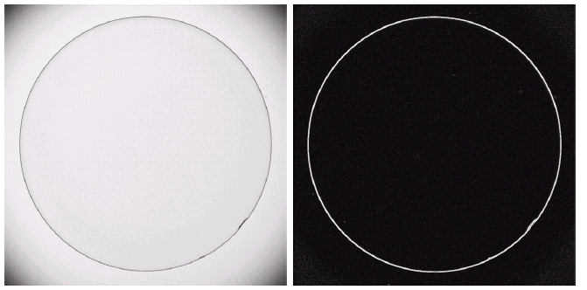
Example
Optical image of contact lens (note defects at 4 and 5 o’ clock
Sobel gradient
COMSATS University Islamabad, Lahore Campus Digital Image Processing CSD 331

